Slide 1
SIMON SAYS
Test memory and reflexes by replicating sequences of colours.

Slide 2
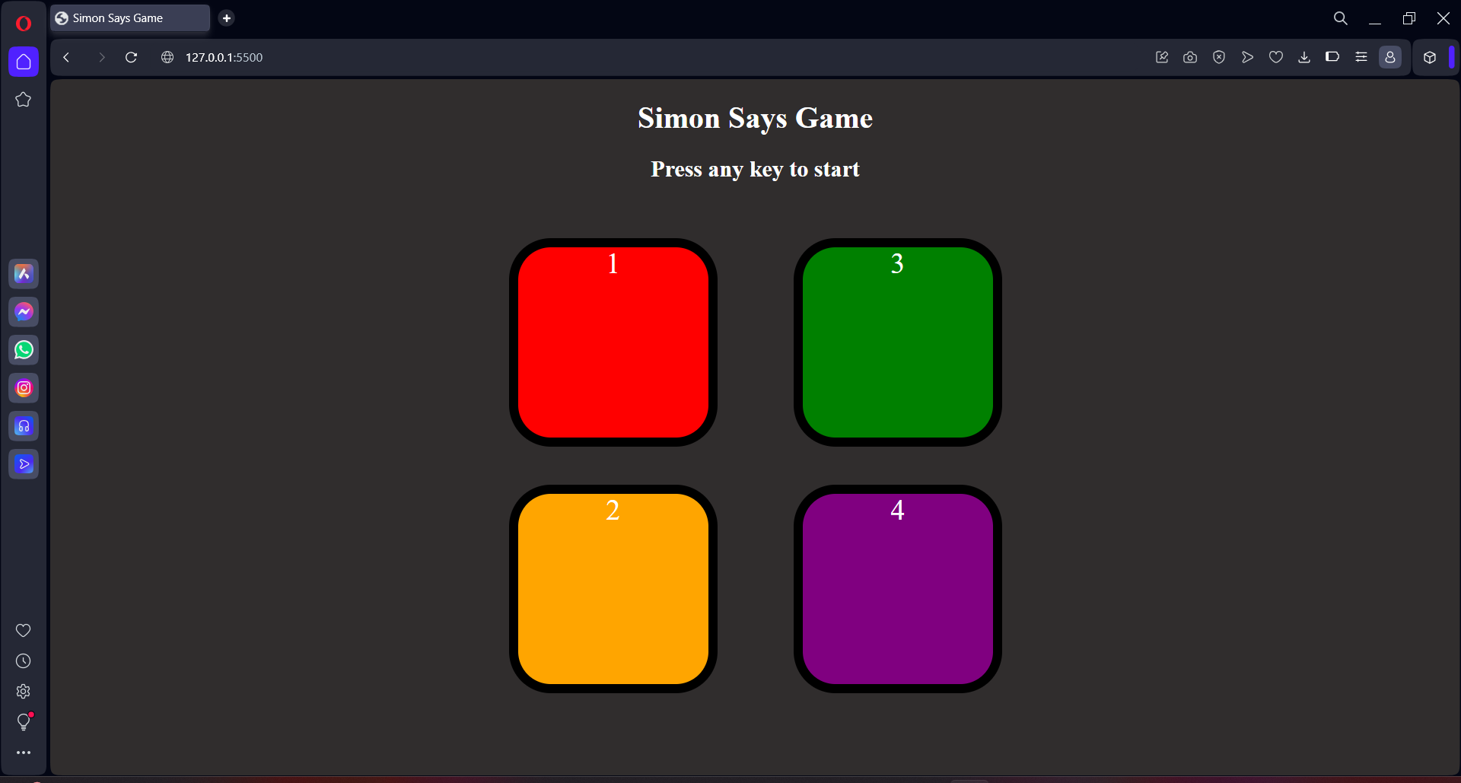
Welcome to Simon Says

Slide 3
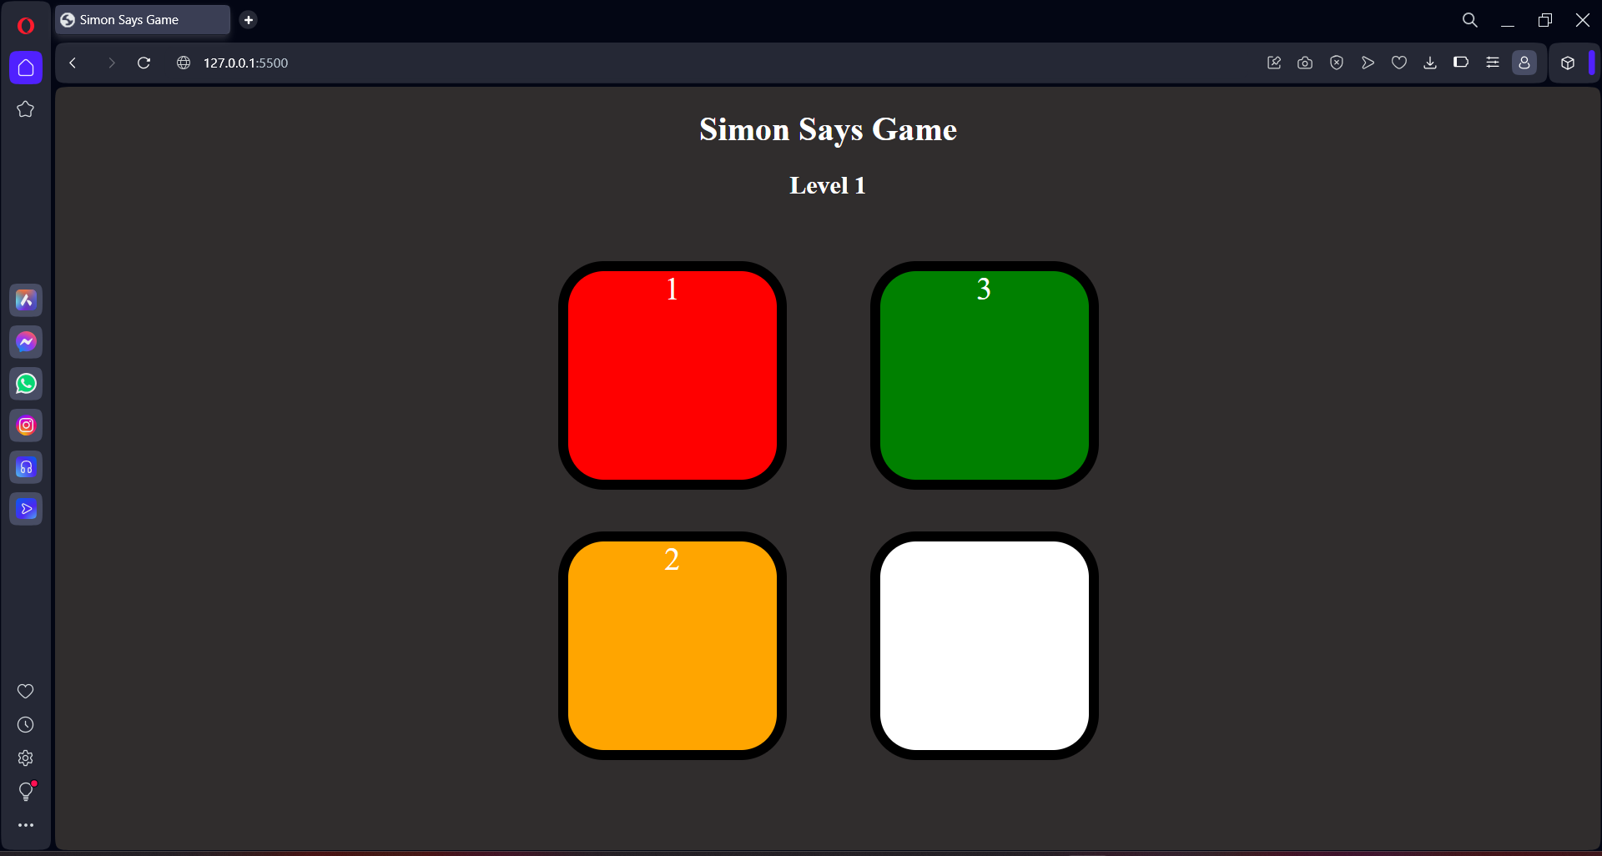
The game starts with the button blink.

Slide 4
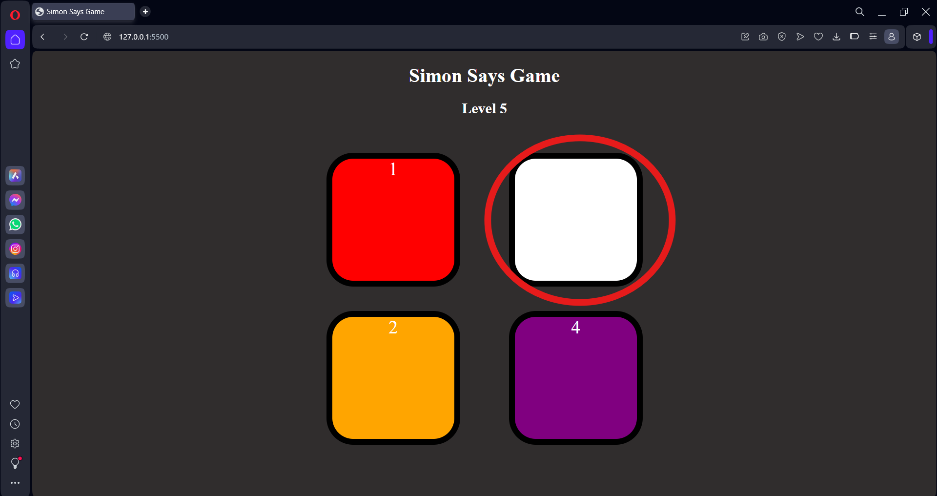
Click on the Next Blinker

Slide 5
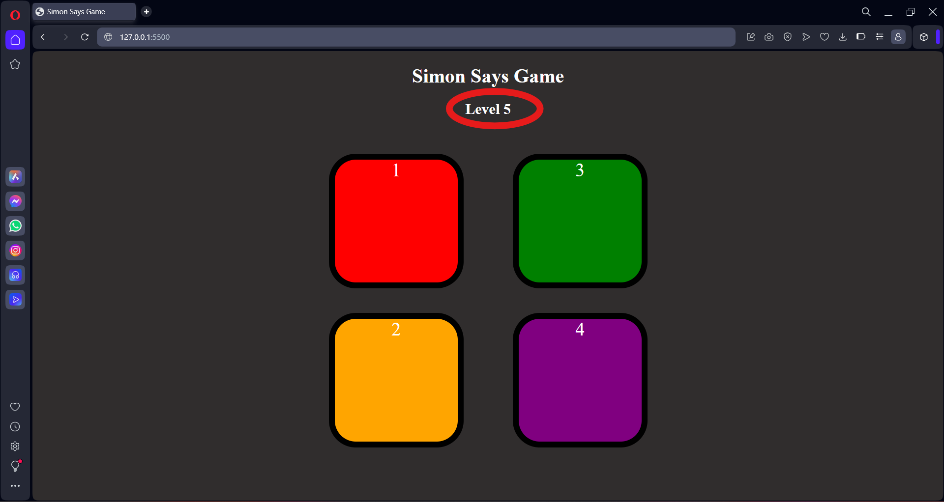
Leveling of Game

Slide 6
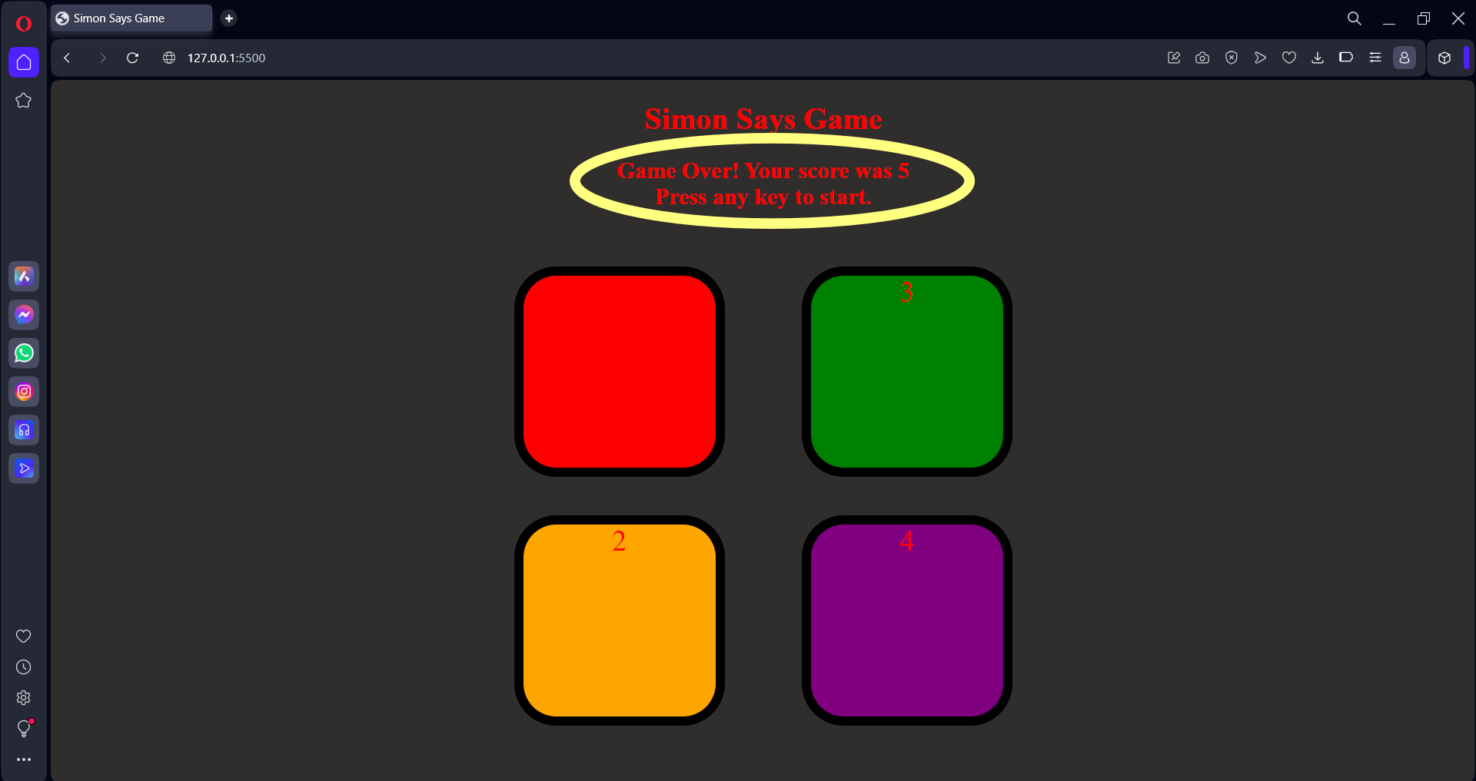
The Final Score

Slide 7
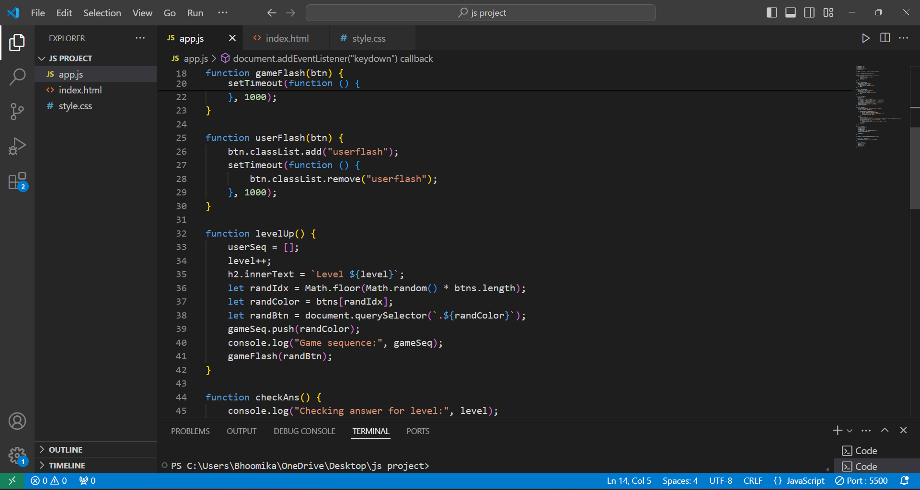
JavaScript File

Slide 8
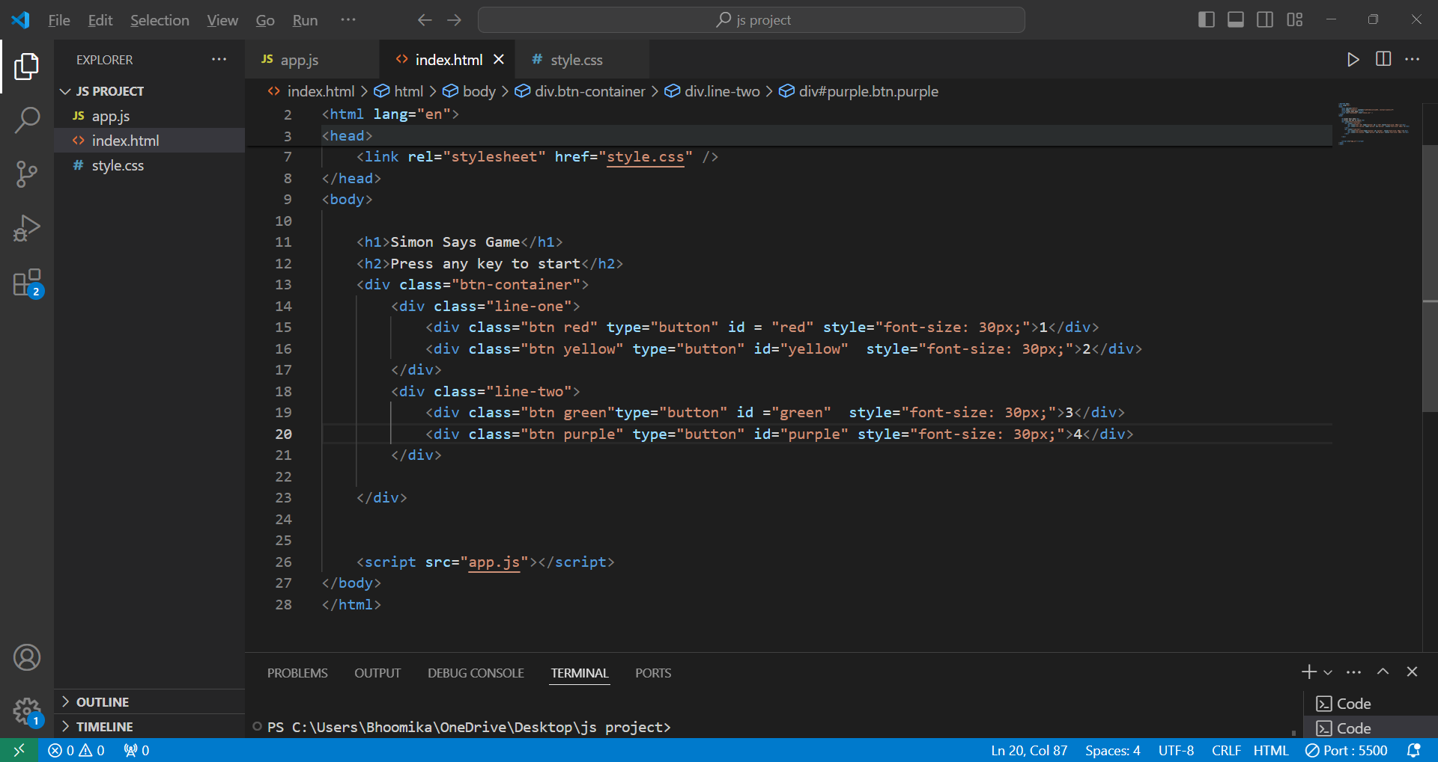
HTML

Slide 9
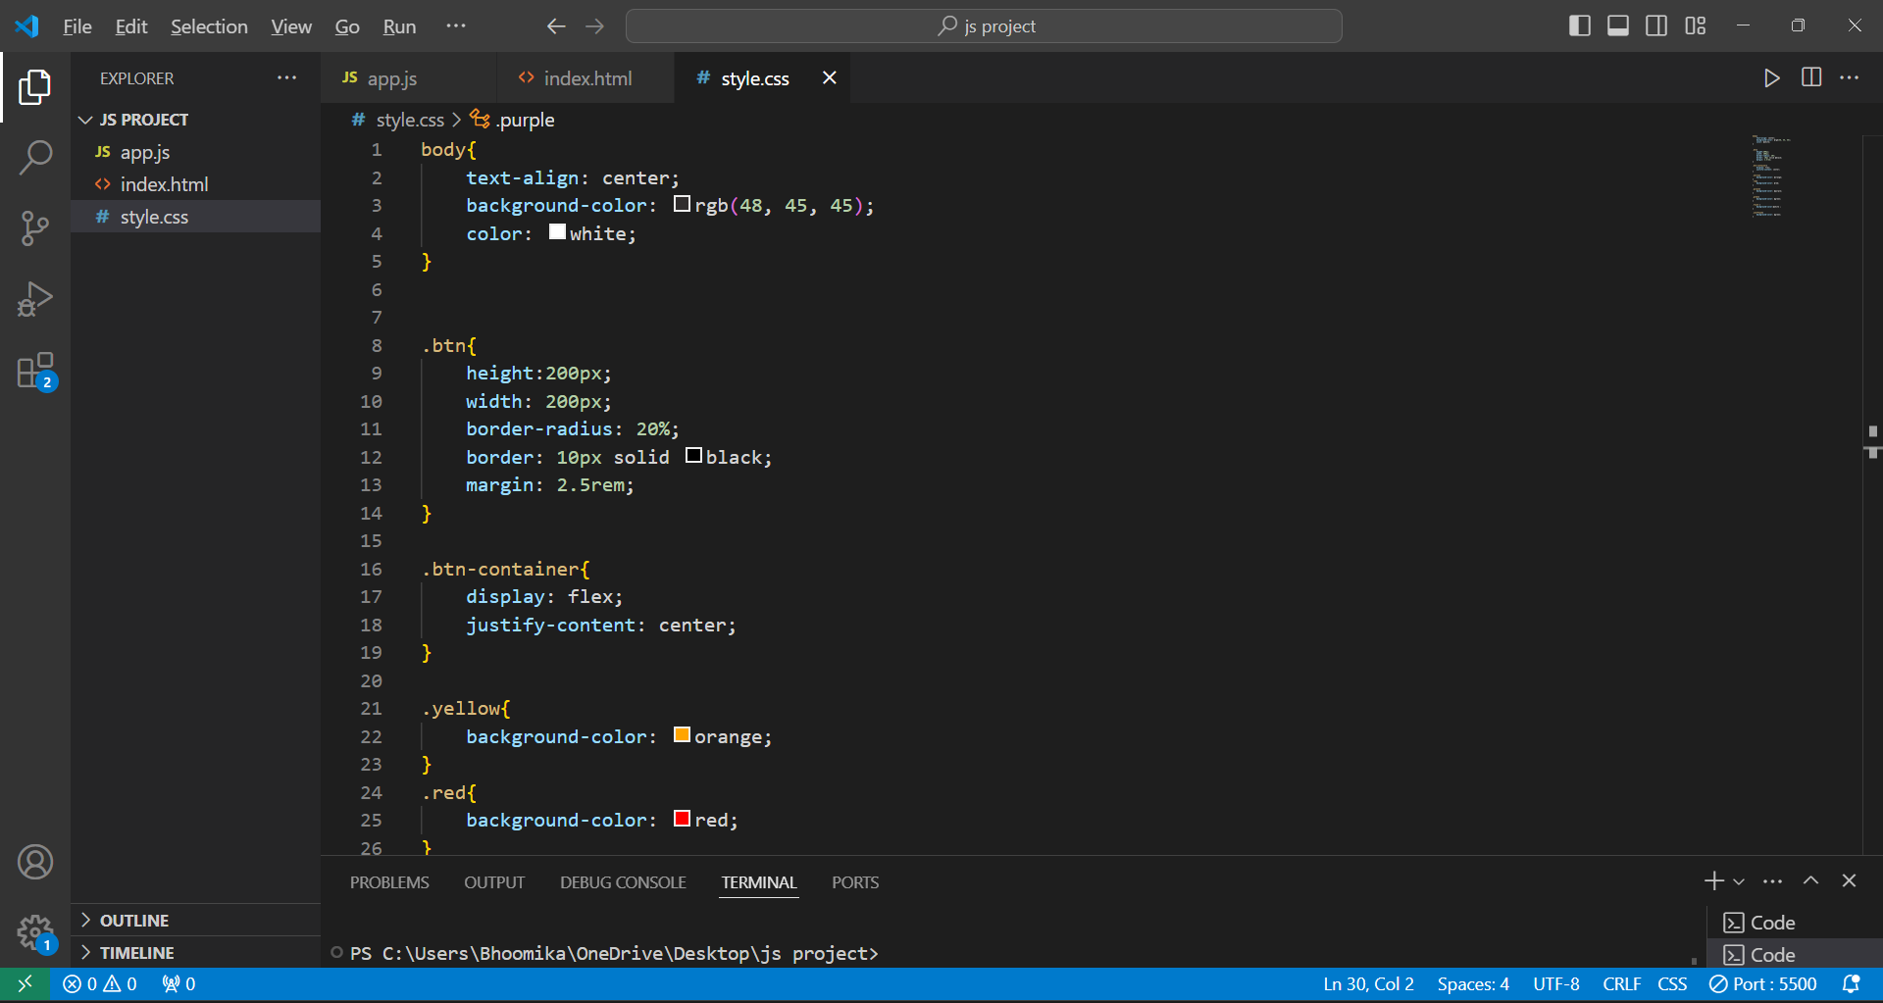
CSS

Slide 10
Thank You!
SIMON SAYS

